Slide 1
Introduction to Javascript

Slide 2
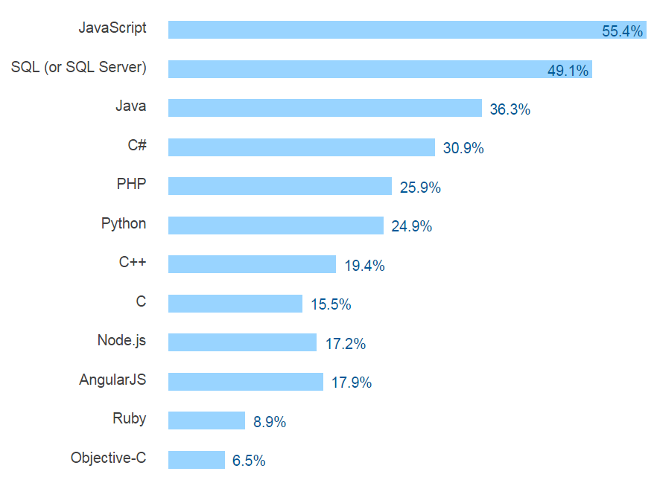
Javascript
Most popular technologies in 2016 (StackOverflow)
https://www.airpair.com/js/javascript-framework-comparison

Slide 3
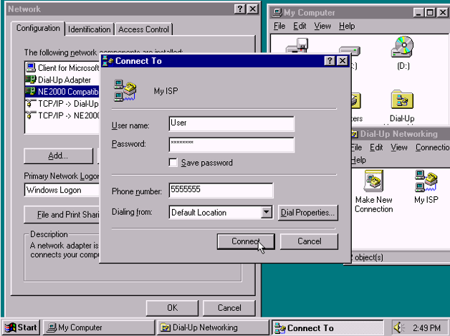
JavaScript History
Javascript is a dynamic computer programming language. It is lightweight and most commonly used as a part of web pages, whose implementations allow client side script to interact with the user and make dynamic pages.
Created in 1995 by Brendan Eich of Netscape… in just 10 days
Mainly for Form validation and adding interactivity to web pages
Browser wars started in 1996 led to the standardization of the language in 1997 (ECMAScript)

Slide 4
Common Uses of JavaScript
Form validation
Page embellishments and special effects
Navigation systems
Basic math calculations
Dynamic content manipulation
…

Slide 5
Javascript language
Javascript is an interpreted programming language with object-oriented capabilities
The ECMA-262 Specification defined a standard version of the core JavaScript language.•
JavaScript is a lightweight, interpreted programming language.
Designed for creating network-centric applications
Complementary to and integrated with Java
Complementary to and integrated with HTML
Open and cross-platform
“Java is to JavaScript what Car is to Carpet”
Chris Heilmann

Slide 6
Language Basics
JavaScript is case sensitive
Statements are terminated by returns or semi-colons
x = x+1; same as x = x+1
“Blocks” of statements enclosed in { …}

Slide 7
Primitive data types
JavaScript has three “primitive” types: number, string, and boolean.
Numbers are always stored as floating-point values
Hexadecimal numbers begin with 0x
Strings may be enclosed in single quotes or double quotes
Strings can contain \n (newline), \" (double quote), etc.
Booleans are either true or false
0, "0", empty strings, undefined, null, and NaN are false , other values are true

Slide 8
Variables
A variable is a container for information you want to store. Variables are defined implicitly by its first use, which must be an assignment. Variables are untyped . The types of variables don’t have to be declared in JavaScript.
A variable's value can change during the script. You can refer to a variable by name to see its value or to change its value.
Variables are declared with a var statement:
Var pi= 3.1416, x, y, name = "Dr. Dave" ;
Variables names must begin with a letter or underscore
Variable names are case-sensitive
The word var is optional (but it’s good style to use it)
Variables declared within a function are local (accessible only within that function)
Variables declared outside a function are global (accessible from anywhere on the page)

Slide 9
Objects
An object is a collection of named properties. Set of name: value pairs
objBob = {name: “Bob", grade: 'A', level: 3};
Objects can have methods
There are three possibilities to create objects in Javascript:
You can use an object literal:
var course = { number: "CIT597", teacher="Dr. Dave" }
You can use new to create a “blank” object, and add fields to it later:
var course = new Object();
course.number = "CIT597";
course.teacher = "Dr. Dave";
You can write and use a constructor:
function Course(n, t) { // best placed in <head> this.number = n; this.teacher = t; }
var course = new Course("CIT597", "Dr. Dave");

Slide 10
Object literals
JavaScript has object literals, written with this syntax: { name1 : value1 , ... , nameN : valueN }
Example: car = {myCar: "Saturn", 7: "Mazda", getCar: CarTypes("Honda"), special: Sales}
The fields are myCar, getCar, 7 (this is a legal field name) , and special
"Saturn" and "Mazda" are Strings
CarTypes is a function call
Sales is a variable you defined earlier
Example use: document.write("I own a " + car.myCar);

Slide 11
Arrays
Arrays can be created in different ways:
You can use an array literal written with brackets and commas: var colors = ["red", "green", "blue"];
Arrays are zero-based: color[0] is "red”
You can use new Array() to create an empty array:
var colors = new Array();
You can add elements to the array later: colors[0] = "red"; colors[2] = "blue"; colors[1]="green";
You can use new Array(n) with a single numeric argument to create an array of that size
var colors = new Array(3);
You can use new Array(…) with two or more arguments to create an array containing those values:
var colors = new Array("red","green", "blue");

Slide 12
Operators
Most JavaScript syntax is borrowed from C:
Arithmetic operators: + - * / % ++ --
Comparison operators: < <= == != >= >
Logical operators: && || !
Bitwise operators: & | ^ ~ << >> >>>
Assignment operators: += -= *= /= %= <<= >>= >>>= &= ^= |=
String operator: +
The conditional operator: condition ? value_if_true : value_if_false
Special equality tests:
== and != try to convert operands to the same type before the test
=== and !== consider their operands unequal if they are of different types
Additional operators: new type of void delete

Slide 13
Arithmetic Operators
Operator | Description | Example | Result
+ | Addition | x=2 | 4
 |  | y=2
 |  | x+y
- | Subtraction | x=5 | 3
 |  | y=2
 |  | x-y
* | Multiplication | x=5 | 20
 |  | y=4
 |  | x*y
/ | Division | 15/5 | 3
 |  | 5/2 | 2,5
% | Modulus (division remainder) | 5%2 | 1
 |  | 10%8 | 2
 |  | 10%2 | 0
++ | Increment | x=5 | x=6
 |  | x++
-- | Decrement | x=5 | x=4
 |  | x--

Slide 14
Assignment Operators
Comparison Operators
Logical Operators
Operator | Example | Is the same as
= | x=y | x=y
+= | x+=y | x=x+y
-= | x-=y | x=x-y
*= | x*=y | x=x*y
/= | x/=y | x=x/y
%= | x%=y | x=x%y
Operator | Description | Example
== | is equal to | 5==8 returns false
=== | is equal to (checks for both value and type) | x=5
 |  | y="5"
 |  | x==y returns true
 |  | x===y returns false
!= | is not equal | 5!=8 returns true
> | is greater than | 5>8 returns false
< | is less than | 5<8 returns true
>= | is greater than or equal to | 5>=8 returns false
<= | is less than or equal to | 5<=8 returns true
Operator | Description | Example
&& | and | x=6
 |  | y=3
 |  | (x < 10 && y >1) returns true
|| | or | x=6
 |  | y=3
 |  | (x==5 || y==5) returns false
! | not | x=6
 |  | y=3
 |  | !(x==y) returns true

Slide 15
Statements
Most JavaScript statements are also borrowed from C. Statements are terminated by returns or semi-colons. Blocks of statements are enclosed in { …}
Assignment:
greeting = "Hello, " + name;
Compound statement: { statement; ...; statement }
If statement: if (condition) statement; if (condition) statement; else statement;
Loop statements: while (condition) statement; do statement while (condition); for (initialization; condition; increment) statement;

Slide 16
For statement
You can loop through all the properties of an object with the
for (variable in object) statement;
Example: for (var prop in course) { document.write(prop + ": " + course[prop]); }
Possible output: teacher: Dr. Dave number: CIT597
The properties are accessed in an undefined order
If you add or delete properties of the object within the loop, it is undefined whether the loop will visit those properties
Arrays are objects; applied to an array, for…in will visit the “properties” 0, 1, 2, …
Notice that course["teacher"] is equivalent to course.teacher. You must use brackets if the property name is in a variable

Slide 17
With statement
with (object) statement ; uses the object as the default prefix for variables in the statement
For example, the following are equivalent:
with (document.myForm) { result.value = compute(myInput.value) ; }
document.myForm.result.value = compute(document.myForm.myInput.value);

Slide 18
Switch statement
The switch statement: switch (expression){ case label : statement; break; case label : statement; break; ... default : statement; }
Other familiar statements:
break;
continue;
The empty statement, as in ;; or { }

Slide 19
Functions
Functions are named statements that perform tasks. They are objects with method called “( )”. A property of an object may be a function (=method). The syntax for defining a function is:
function name(arg1, …, argN) { statements }
Simple parameters are passed by value, objects are passed by reference. The function may contain return value. Any variables declared within the function are local to it
function max(x,y) { if (x>y) return x; else return y;};
max.description = “return the maximum of two arguments”;
Functions should be defined in the <head> of an HTML page, to ensure that they are loaded first.
JavaScript has built-in functions, and you can write your own.

Slide 20
Regular expressions
Expressions are commands that assign values to variables. A regular expression can be written in either of two ways:
Within slashes, such as re = /ab+c/
With a constructor, such as re = new RegExp("ab+c")
string.match(regexp) searches string for an occurrence of regexp
It returns null if nothing is found
If regexp has the g (global search) flag set, match returns an array of matched substrings
If g is not set, match returns an array whose 0t^{h} element is the matched text, extra elements are the parenthesized subexpressions, and the index property is the start position of the matched substring

Slide 21
Comments
Comments are as in C or Java:
Between // and the end of the line
Between /* and */

Slide 22
Client-side Javascript
Client-side JavaScript is the most common form of the language. The script should be included in or referenced by an HTML document for the code to be interpreted by the browser.
It means that a web page need not be a static HTML, but can include programs that interact with the user, control the browser, and dynamically create HTML content.
The script is integrated into a web page in two modalities:
By associating JavaScript functions to the events we want to manage
By accessing to the properties of the objects that are in the page
All the modern browsers come with built-in support for JavaScript.

Slide 23
The merits of using JavaScript are:
Less server interaction: You can validate user input before sending the page off to the server. This saves server traffic, which means less load on your server.
Immediate feedback to the visitors: They don't have to wait for a page reload to see if they have forgotten to enter something.
Increased interactivity:You can create interfaces that react when the user hovers over them with a mouse or activates them via the keyboard.
Richer interfaces: You can use JavaScript to include such items as drag-and-drop components and sliders to give a Rich Interface to your site visitors

Slide 24
Syntax
JavaScript can be implemented using JavaScript statements that are placed within the <script>... </script> HTML tags in a web page. The <script> tag alerts the browser program to start interpreting all the text between these tags as a script
You can place the <script> tags anywhere in the web page:
If you want to have a script run on some event, such as when a user clicks somewhere, then you will place that script in the <head>.
If you need a script to run as the page loads so that the script generates content in the page, then the script goes in the <body> portion of the document.
The script tag takes two important attributes:
Language: specifies what scripting language you are using. Typically, its value will be javascript (can be omitted)
Type: This attribute is what is now recommended to indicate the scripting language in use and its value should be set to "text/javascript”

Slide 25
Embedding JavaScript in HTML
As statements and functions via <script> tag
<script type=“text/javascript” src=“some file.js” > javascript statements...if not external </script>
Attributes: ttype, src
The src attribute is used when Javascripts reside in a separate page. Linking can be advantageous if many pages use the same script.
Within HTML tags as event handlers…
e.g., <body onLoad="alert('WELCOME)”>')">
Provide the doorway between HTML and Scripts

Slide 26
Example 1: Add Two Numbers
<html>
…
<p> … </p>
<script>
var num1, num2, sum
num1 = prompt("Enter first number")
num2 = prompt("Enter second number")
sum = parseInt(num1) + parseInt(num2)
alert("Sum = " + sum)
</script>
…
</html>

Slide 27
Example 2: Browser Events
Mouse event causes page-defined function to be called
Other events: onLoad, onMouseMove, onKeyPress, onUnLoad
<script type="text/JavaScript">
function whichButton(event) {
if (event.button==1) {
alert("You clicked the left mouse button!") }
else {
alert("You clicked the right mouse button!")
}}
</script>
…
<body onmousedown="whichButton(event)">
…
</body>

Slide 28
HTML DOM
The Browser exports to Javascript an object model of the page referred to as DOM (Document Object Model). This is a structured representation of the document as a tree, to represent, store and manipulate that same document. It defines methods that allow access to the tree, so that they can change the document structure, style and content.
DOM is a programming interface for HTML, XML and SVG documents.
The W3C DOM and WHATWG DOM standards form the basis of the DOM implemented in most modern browsers. For example, the standard DOM specifies that the getElementsByTagName method in the code below must return a list of all the <P> elements in the document:
var paragraphs = document.getElementsByTagName("P");
// paragraphs[0] is the first <p> element
// paragraphs[1] is the second <p> element, etc.
alert(paragraphs[0].nodeName);

Slide 29
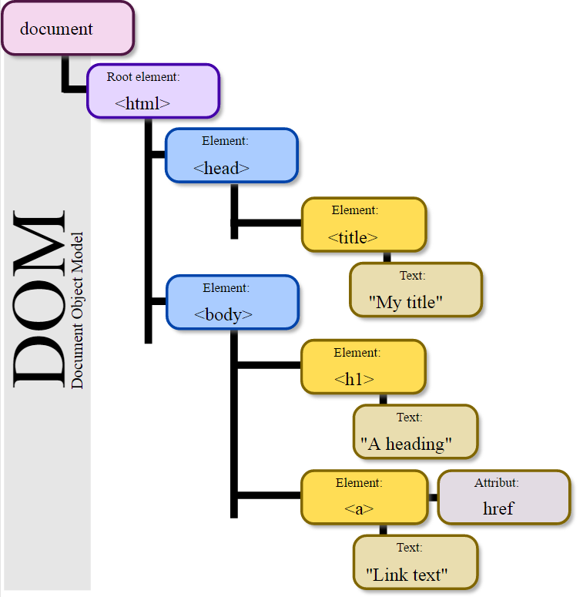
The DOM provides a tree- representation of the document as a structured group of nodes and objects, possessing various properties and methods.
Nodes can also have event handlers attached to them, and once an event is triggered, the event handlers get executed.
DOM Traversal is a process of finding nodes in the tree
DOM Manipulation is about changing the tree structure (adding or removing nodes, changing text, etc.)
Examples:
“Highlight the third option of the list”
“Wrap each paragraph in a DIV”
Source: Wikipedia
Notes:
jQuery was originally released in January 2006 at BarCamp NYC by John Resig and was influenced by Dean Edwards' earlier cssQuery library.

Slide 30
Accessing the DOM
You don't have to do anything special to begin using the DOM
When you create a script you can immediately begin using the API for the document or window elements to manipulate the document itself or to get at the children of that document, which are the various elements in the web page.
Objects refer to windows, documents, images, tables, forms, buttons or links, etc. Properties are object attributes.
Object properties are defined by using the object's name, a period, and the property name: E.g. document.bgcolor .
A JavaScript function uses these objects by calling their methods and accessing to their properties. Methods are actions applied to particular objects.
Events associate an object with an action. User actions trigger events: e.g., the OnMouseover event handler action can change an image

Slide 31
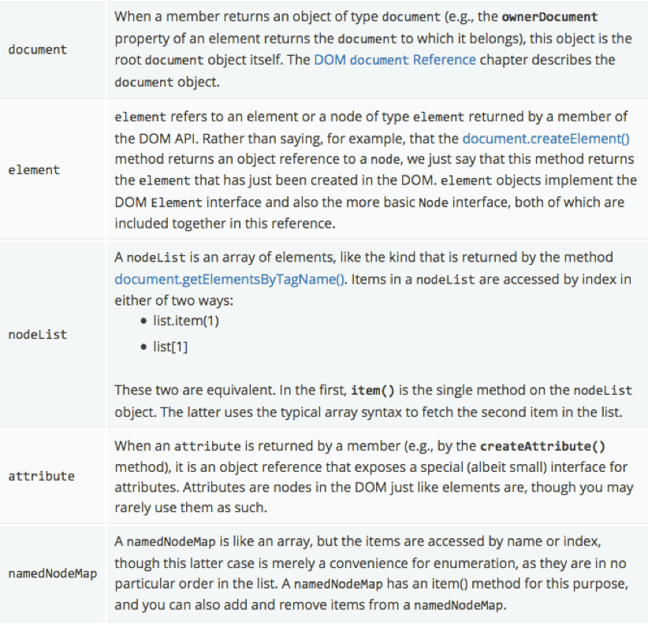
Important Data Types
There are a number of different data types being passed around the API:

Slide 32
Most common APIs
The following is a brief list of common APIs in web page scripting using the DOM:
document.getElementById(id)
document.getElementsByTagName(name)
document.createElement(name)
parentNode.appendChild(node)
element.innerHTML
element.style.left
element.setAttribute
element.getAttribute
element.addEventListener
window.content
window.onload
window.dump
window.scrollTo

Slide 33
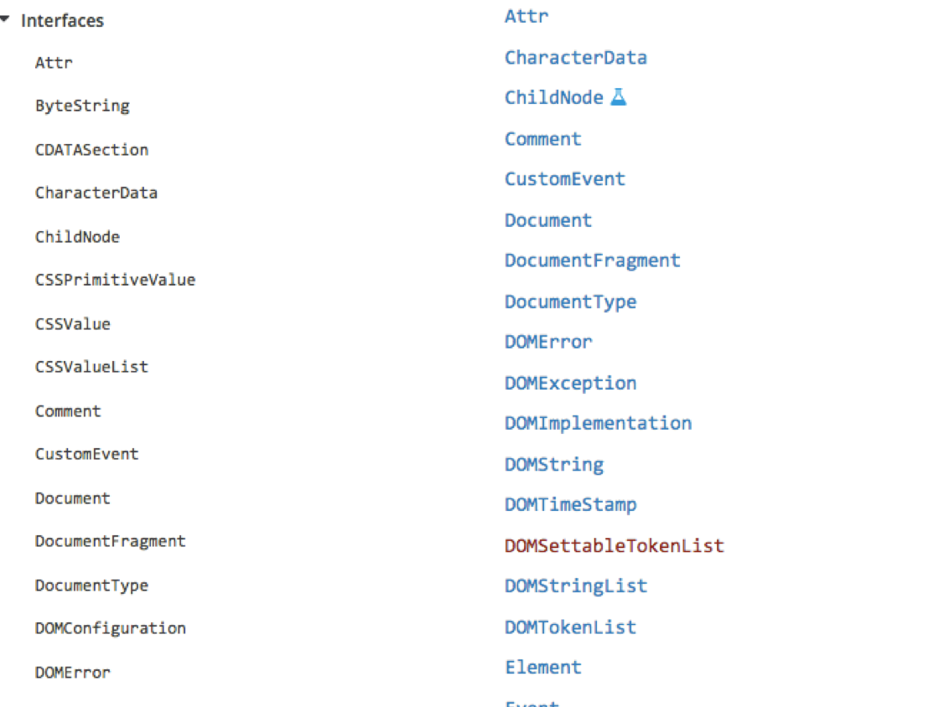
DOM interfaces

Slide 34
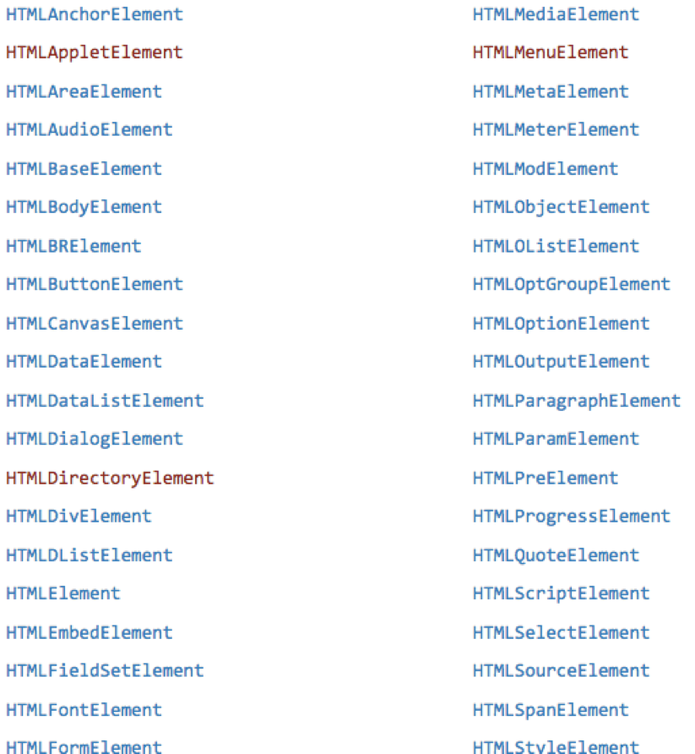
DOM HTML element interfaces
And many others…

Slide 35
Example 4: Reading Properties
Sample script
Example 1 returns "ul"
Example 2 returns "null"
Example 3 returns "li"
Example 4 returns "text” A text node below the "li" which holds the actual text data as its value
Example 5 returns " Item 1 "
Sample HTML
1. document.getElementById('t1').nodeName
2. document.getElementById('t1').nodeValue
3. document.getElementById('t1').firstChild.nodeName
4. document.getElementById('t1').firstChild.firstChild.nodeName
5. document.getElementById('t1').firstChild.firstChild.nodeValue
<ul id="t1">
<li> Item 1 </li>
</ul>

Slide 36
Example 4: Page Manipulation
Some possibilities
createElement(elementName)
createTextNode(text)
appendChild(newChild)
removeChild(node)
Example: add a new list item
var list = document.getElementById('t1')
var newitem = document.createElement('li')
var newtext = document.createTextNode(text)
list.appendChild(newitem)
newitem.appendChild(newtext)
This uses the Browser Document Object Model (DOM). We will focus on JavaScript as a language,
not its use in the browser

Slide 37
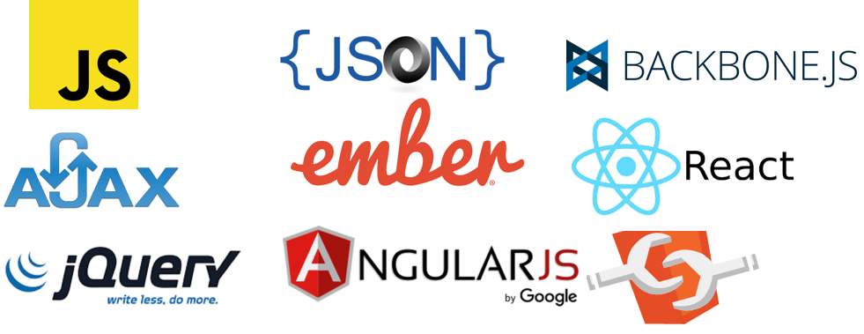
Modern Javascript Libraries and Frameworks
There are a number of Javascript libraries and frameworks available for developers
Notes:
http://noeticforce.com/best-Javascript-frameworks-for-single-page-modern-web-applications
http://tutorialzine.com/2015/12/the-languages-and-frameworks-you-should-learn-in-2016/
https://colorlib.com/wp/javascript-frameworks/

Slide 38

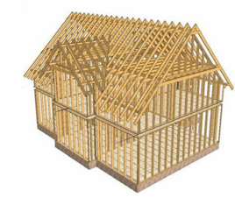
Frameworks vs Libraries
A Library is a collection of commonly used functions, usually independent of each other
Plain JavaScript along with jQuery has been used for years to build complex web interfaces but with lot more effort and complexity in code development and maintenance.
A Framework is a set of functions for achieving a certain task (such as creating an user interface). Frameworks usually define the overall program’s flow of control
Use of JavaScript Frameworks give you space to focus on developing interactive elements of the user interface without worrying too much about code structure and code maintenance.
Notes:
Plain JavaScript along with jQuery has been used for years to build complex web interfaces but with lot more effort and complexity in code development and maintenance.
Use of JavaScript Frameworks give you space to focus on developing interactive elements of the user interface without worrying too much about code structure and code maintenance.
Most of the JavaScript frameworks work on MVC design paradigm and enforce structure to ensure more scalable, reusable, maintainable JavaScript code.
It however is not necessary that all frameworks ride on MVC pattern, there are many variations to it and one has choice to go with MV*, MVVM, MVP as is best suited to the project needs.

Slide 39
JSON JavaScript Object Notation
Lightweight data-interchange format
Based on JavaScript, created in 2001
Easy for humans to read and write
Easy for computers to parse and generate
Natively supported by browsers since 2009
{ "name": “Rostislav Titov", "employer": "CERN", "title": "Software Engineer", "married": true, "born": 1973,
“children": [ “Svetlana", “Xenia" ]
}

Slide 40
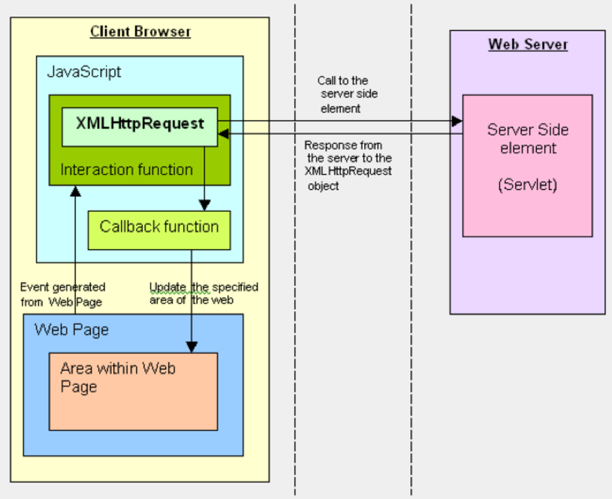
AJAX Asynchronous JavaScript and XML
First mentioned in 2005
Load content asynchronously in the background, via XMLHttpRequest
Dynamically update the page with the results of the request, via Dynamic HTML

Slide 41
jQuery Library
Originally released in January 2016 at BarCamp NYC by John Resig
Most popular JavaScript library
Bundled with Microsoft.Net
Used in >65% of most popular sites (e.g. Wikipedia).
It’s a collection of functions for:
Document traversal
HTML manipulation
Animation
AJAX
Event Handling
Notes:
jQuery was originally released in January 2006 at BarCamp NYC by John Resig and was influenced by Dean Edwards' earlier cssQuery library.

Slide 42
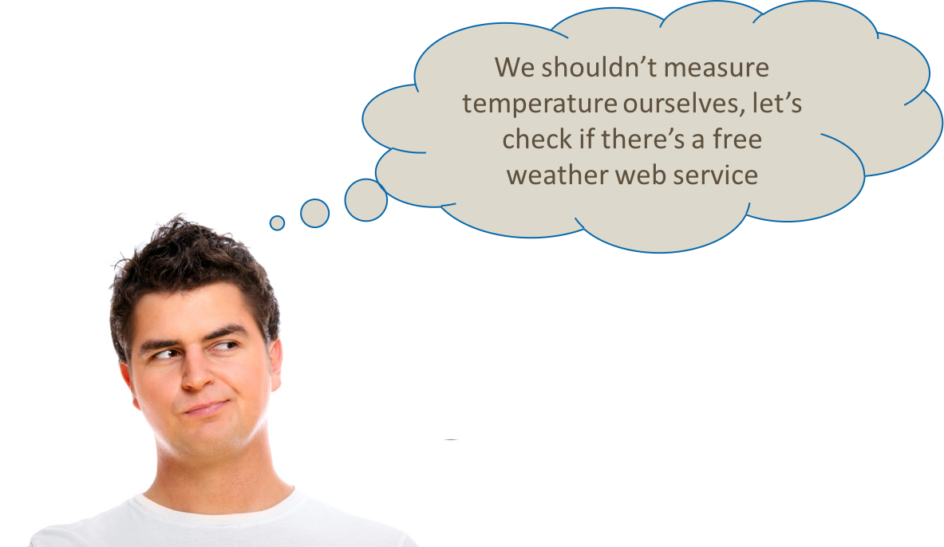
JQuery Example
Create a Web application which shows the current temperature in Dubai
openweathermap.org
Notes:
http://noeticforce.com/best-Javascript-frameworks-for-single-page-modern-web-applications
http://tutorialzine.com/2015/12/the-languages-and-frameworks-you-should-learn-in-2016/
https://colorlib.com/wp/javascript-frameworks/

Slide 43
<!doctype html> <html lang="en"> <head> <title>AJAX Example</title> <style>#temp { color: #a80f22 } </style> </head> <body> <script src="jquery-3.1.1.min.js"></script> <script> $(function() { $('#btn').on('click', function() { $.get('http://api.openweathermap.org/data/2.5/weather?id=564719&units=metric' + '&APPID=b085303ece99541bdea7e19add36bcd3') .done(function(data) { $("#temp").html(data.main.temp + '&deg;C'); }) .fail(function() { window.alert("An error happened"); }); $("#example1 p").css("color", "blue"); }); }) </script> <h1>Current temperature in Dubna is: <span id="temp"></span></h1> <button type="text" id="btn">Check weather</button> </body> </html>
First of all, we need to include jQuery into our HTML file

Slide 44
<!doctype html> <html lang="en"> <head> <title>AJAX Example</title> <style>#temp { color: #a80f22 } </style> </head> <body> <script src="jquery-3.1.1.min.js"></script> <script> $(function() { $('#btn').on('click', function() { $.get('http://api.openweathermap.org/data/2.5/weather?id=564719&units=metric' + '&APPID=b085303ece99541bdea7e19add36bcd3') .done(function(data) { $("#temp").html(data.main.temp + '&deg;C'); }) .fail(function() { window.alert("An error happened"); }); $("#example1 p").css("color", "blue"); }); }) </script> <h1>Current temperature in Dubna is: <span id="temp"></span></h1> <button type="text" id="btn">Check weather</button> </body> </html>
$(function() {
…
})
This function is called after the document has been fully loaded and it is safe to manipulate its contents.

Slide 45
<!doctype html> <html lang="en"> <head> <title>AJAX Example</title> <style>#temp { color: #a80f22 } </style> </head> <body> <script src="jquery-3.1.1.min.js"></script> <script> $(function() { $('#btn').on('click', function() { $.get('http://api.openweathermap.org/data/2.5/weather?id=564719&units=metric' + '&APPID=b085303ece99541bdea7e19add36bcd3') .done(function(data) { $("#temp").html(data.main.temp + '&deg;C'); }) .fail(function() { window.alert("An error happened"); }); $("#example1 p").css("color", "blue"); }); }) </script> <h1>Current temperature in Dubna is: <span id="temp"></span></h1> <button type="text" id="btn">Check weather</button> </body> </html>
$(‘#btn’)
DOM Traversal. Here we find the HTML element (our button) by its unique ID (“btn”)
jQuery has very powerful capabilities of finding elements
Select an element by its ID, class name, attribute value, …
Select by complex path (e.g. div > p > img)
Pseudoclasses (e.g. :not, :last, :visible, :parent, :even, …)

Slide 46
<!doctype html> <html lang="en"> <head> <title>AJAX Example</title> <style>#temp { color: #a80f22 } </style> </head> <body> <script src="jquery-3.1.1.min.js"></script> <script> $(function() { $('#btn').on('click', function() { $.get('http://api.openweathermap.org/data/2.5/weather?id=564719&units=metric' + '&APPID=b085303ece99541bdea7e19add36bcd3') .done(function(data) { $("#temp").html(data.main.temp + '&deg;C'); }) .fail(function() { window.alert("An error happened"); }); $("#example1 p").css("color", "blue"); }); }) </script> <h1>Current temperature in Dubna is: <span id="temp"></span></h1> <button type="text" id="btn">Check weather</button> </body> </html>
element.on('click', function() { … });
Event handling. The function will be executed when the user clicks on the element (our button).

Slide 47




jQuery-based Libraries
Lots of free open source libraries based on jQuery
Before doing anything, check if a plugin exists (it probably does!)
Set of user interface interactions, effects, widgets, and themes on top of jQuery
HTML5-based user interface system to make responsive mobile/desktop web sites
Customizable select boxes with AJAX, tagging, searching, etc.
Example:
Notes:
http://noeticforce.com/best-Javascript-frameworks-for-single-page-modern-web-applications
http://tutorialzine.com/2015/12/the-languages-and-frameworks-you-should-learn-in-2016/
https://colorlib.com/wp/javascript-frameworks/

Slide 48
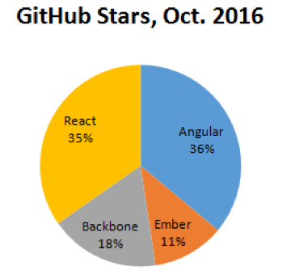
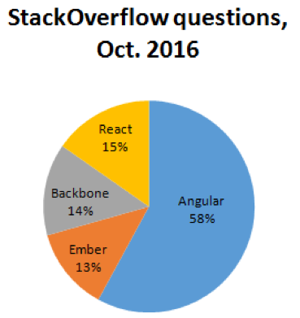
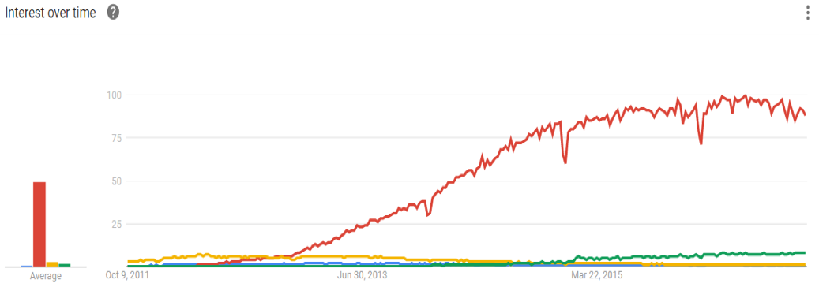

JavaScript Frameworks
 | Angular | Ember | Backbone | React
GitHub stars | 53k | 17k | 26k | 51k
GitHub contributors | 1529 | 618 | 290 | 799
Stackoverflow questions | 201k | 44k | 49k | 53k
Size (minified+GZip) | 56k | 110k | 8k | 44k
Sources: GitHub, StackOverflow
Source: Google Trends
Notes:
http://noeticforce.com/best-Javascript-frameworks-for-single-page-modern-web-applications
http://tutorialzine.com/2015/12/the-languages-and-frameworks-you-should-learn-in-2016/
https://colorlib.com/wp/javascript-frameworks/

Slide 49
ANGULAR JS Framework by Google
Everything needed to create the client-side interface
Declarative templates with 2-way data binding
Reusable components with directives
Dependency injection
Designed for great testability
Big user community
Angular 2 (released September 2016). Completely rewritten, lots of differences from Angular 1
Plus
Minus
Most powerful
Most popular
Good testing support
Concerns about version changes
Focused on Google stack

Slide 50
Angular Example 1
<!doctype html> <html lang="en"> <head> <meta charset="utf-8"> <title>Angular Example</title> <script src="node_modules/angular/angular.min.js"></script> </head> <body ng-app> <h1>Angular Example</h1> <form method="get"> <input type="text" ng-model="name" placeholder="Enter a name"> <p>Welcome {{name}}</p> </form> </body> </html>
Notes:
http://noeticforce.com/best-Javascript-frameworks-for-single-page-modern-web-applications
http://tutorialzine.com/2015/12/the-languages-and-frameworks-you-should-learn-in-2016/
https://colorlib.com/wp/javascript-frameworks/

Slide 51
REACT Framework
Framework for creating user interface components
Developed by Facebook
Not a full-size framework
It’s only the View part of Model-View-Controller
Doesn’t replace Angular but can be used with it
Essentially, it is a template engine for HTML rendering
Plus
Minus
Declarative views
Reusable components
Server-side rendering
No AJAX, events, data layer…
Steep learning curve
Big size for its features
Notes:
Declarative: React makes it painless to create interactive UIs. Design simple views for each state in your application, and React will efficiently update and render just the right components when your data changes.
Declarative views make your code more predictable and easier to debug.
Component-Based: Build encapsulated components that manage their own state, then compose them to make complex UIs.
Since component logic is written in JavaScript instead of templates, you can easily pass rich data through your app and keep state out of the DOM.

Slide 52
EMBER Framework
for ambitious web applications. Created by Yehuda Katz and Tom Dale
Builds on the best ideas from Angular and React
Two-way data binding
Good performance (server-side rendering possible)
Nice development process
Plus
Minus
Excellent page router
Good performance
Maybe not for small apps
Handlebars templates pollute DOM
Biggest size
Notes:
FastBoot. An Ember CLI addon that allows you to render and serve Ember.js apps on the server. Using FastBoot, you can serve rendered HTML to browsers and other clients without requiring them to download JavaScript assets.
Ember's internals and most of the code you will write in your applications takes place in a run loop. The run loop is used to batch, and order (or reorder) work in a way that is most effective and efficient.

Slide 53
BACKBONE JS Framework
Tiny yet powerful
Linear learning curve
Good foundation to build your framework
No two-way data binding
Views manipulate the DOM directly (= hard to test)
May be useful as a side framework, but not as a core one
Plus
Minus
Tiny size
Simple code, well documented
Good basis for building your own framework
Requires dependencies (i.e. jQuery)
No two-way data binding
Could be messy and hard to test

Slide 54
Components
Most of the JavaScript frameworks work on MVC, MV*, MVVM, MVP design pattern paradigm and enforce structure to ensure more scalable, reusable, maintainable JavaScript code.
Applications without components are typically hard to debug and maintain
A typical task: an application needs a header showing the user name.
Where the username is set?
Who has access?
Which dependencies it has?
What if we want to change design?
What if we need to change library/framework?
<div class="header"> <div id="username"></div> </div> ... $("#username").html("Slava");
This is how we can do it with a component:
<appHeader username="Slava"></appHeader>

Slide 55
http://webcomponents.org/
A web component is a standardized way of creating encapsulated, reusable user interface elements for the web.
Main Principles:
Encapsulation: A component should be completely standalone. This increases reusability, testability and reliability
Extensibility: Components should be able to extend each other and other DOM elements → extend and reuse functionality
Composability: It should be possible to create more complex components or even entire applications from components.

Slide 56
Why Web Components
Web components are built on nothing more than web standards, this has some huge benefits:
Interoperability: Components can be used with different frameworks, in multiple projects of different technology stacks
Lifespan: Interoperable components will have a longer life; less need to re-write them to fit into newer technologies
Portability: Components not relying on library or framework are much easier to re-use

Slide 57
What library/framework/technology to use
No universal solution.
Look at your project requirements
Look at how much server-side/client side (do you need a JavaScript framework, or a library is enough?)
Look at your existing expertise
If you need a framework, Angular seems to be a safe choice… but Ember is probably equally good
Web components seem to be the future

Slide 58
References
http://www.html.it/guide/guida-javascript-di-base/

